Slide 1
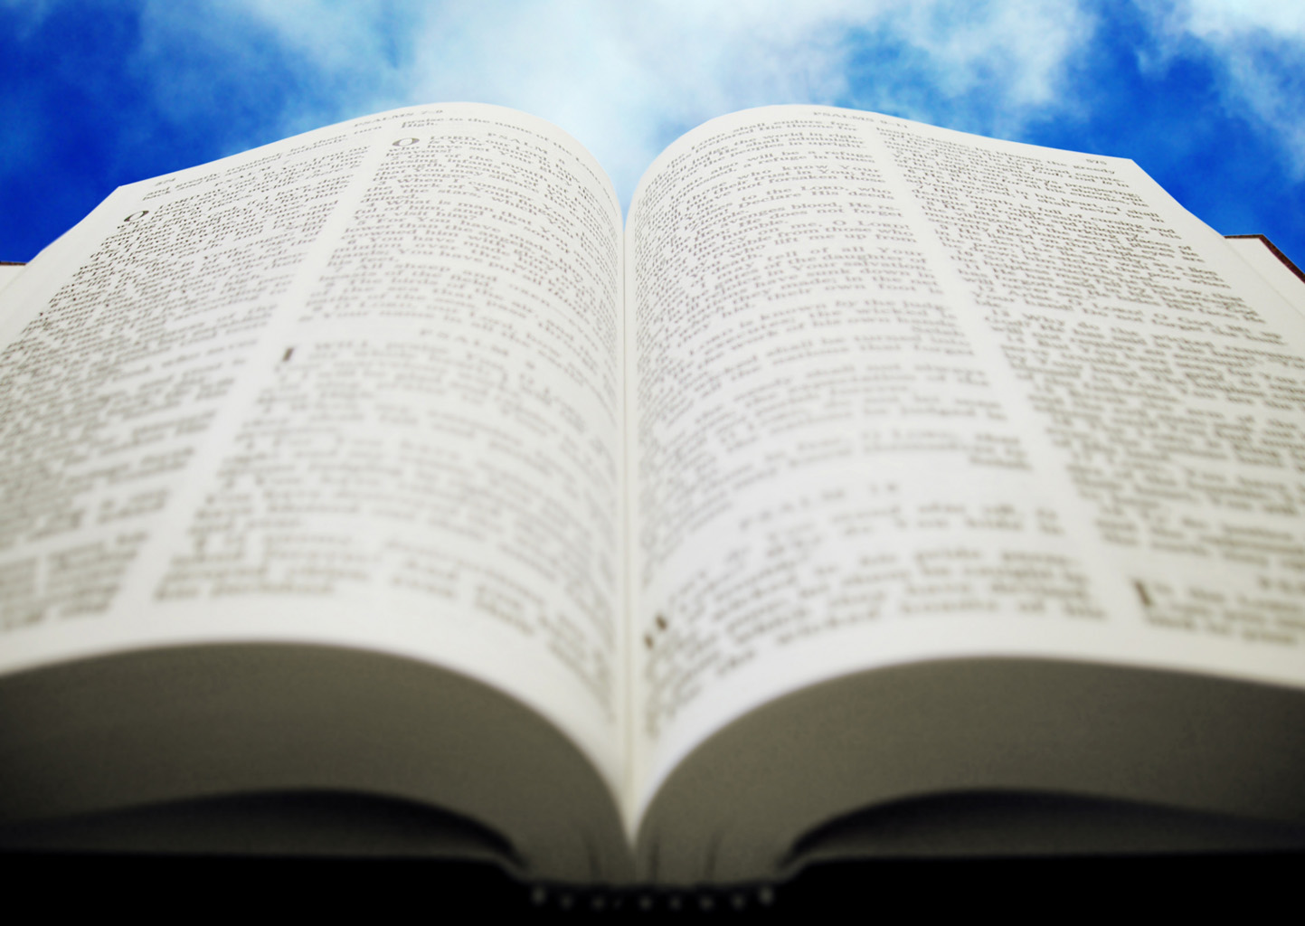
Welcome!
Sunday
Worship 10:00 AM
Sunday
Bible Class (Livestream) 5:00 PM
Wednesday
Bible Class 7:00 PM
www.SunsetchurchofChrist.net

Slide 2
Opening Prayer | Lamar McDonald
Song – | Craig Foster
Song – | Craig Foster
Lord’s Supper | Michael Hetzer
Song – | Craig Foster
Song – | Craig Foster
Lesson | Brian Haines
Song – | Craig Foster
Closing | Rob Wade
1 Corinthians 16:2
On the first day of the week let each one of you lay something aside, storing up as he may prosper, that there be no collections when I come.
A collection basket
is in the foyer

Slide 3
Handling the
Word of God

Slide 4
Handling the Word
Be diligent to present yourself approved to God as a workman who does not need to be ashamed, accurately handling the word of truth. 2 Timothy 2:15

Slide 5
Handling the Word
Accurate handling:
Using in a way that works
Avoiding injury or damage
Why must we handle it accurately?

Slide 6
Because it is a Weapon
And take the helmet of salvation, and the sword of the Spirit, which is the Word of God; Ephesians 6:17

Slide 7
Because it is a Weapon
For the word of God is living and powerful, and sharper than any two-edged sword, piercing even to the division of soul and spirit, and of joints and marrow, and is a discerner of the thoughts and intents of the heart. Hebrews 4:12

Slide 8
Because it is a Foundation
"Whoever comes to Me, and hears My sayings and does them, I will show you whom he is like: He is like a man building a house, who dug deep and laid the foundation on the rock. And when the flood arose, the stream beat vehemently against that house, and could not shake it, for it was founded on the rock.” Luke 6:47

Slide 9
Because it is Your Food
But He answered and said, "It is written, 'Man shall not live by bread alone, but by every word that proceeds from the mouth of God.'“ Matthew 4:4

Slide 10
Because it is Your Food
As newborn babes, desire the pure milk of the word, that you may grow thereby, if indeed you have tasted that the Lord is gracious 1 Peter 2:2-3
Notes:
Mt 10:32 "Therefore whoever confesses Me before men, him I will also confess before My Father who is in heaven. 33 "But whoever denies Me before men, him I will also deny before My Father who is in heaven.

Slide 11
Because it is a Light
Your word is a lamp to my feet and a light to my path. Psalm 119:105
Notes:
Jer 10:23 O LORD, I know the way of man is not in himself; It is not in man who walks to direct his own steps.

Slide 12
Because it is a Light
And so we have the prophetic word confirmed, which you do well to heed as a light that shines in a dark place, until the day dawns and the morning star rises in your hearts; 2 Peter 1:19
Notes:
Jer 10:23 O LORD, I know the way of man is not in himself; It is not in man who walks to direct his own steps.

Slide 13
Because it is a Fire
"Is not My word like a fire?" says the LORD, "And like a hammer that breaks the rock in pieces? Jeremiah 23:29
Notes:
Jer 5:14 Therefore thus says the LORD God of hosts: "Because you speak this word, Behold, I will make My words in your mouth fire, And this people wood, And it shall devour them.

Slide 14
Because it is a Mirror
For if anyone is a hearer of the word and not a doer, he is like a man observing his natural face in a mirror; for he observes himself, goes away, and immediately forgets what kind of man he was. But he who looks into the perfect law of liberty and continues in it, and is not a forgetful hearer but a doer of the work, this one will be blessed in what he does. James 1:23
Notes:
Jer 5:14 Therefore thus says the LORD God of hosts: "Because you speak this word, Behold, I will make My words in your mouth fire, And this people wood, And it shall devour them.

Slide 15
Accurately Handling
The dangers of mishandling the Word:
Being judged – John 12:48
Being deceived – 2 Thessalonians 2:10
Notes:
Joh 12:48 "He who rejects Me, and does not receive My words, has that which judges him--the word that I have spoken will judge him in the last day.

Slide 16
Application
Take a moment and ask yourself:
What if God gives me in my measure?
What measure do I ask of God?
What ways can I increase my measure?

Slide 18
Because it is a Seed
"Now the parable is this: The seed is the word of God.” Luke 8:11

Slide 19
Because it is a Seed
Having been born again, not of corruptible seed but incorruptible, through the word of God which lives and abides forever 1 Peter 1:23

Slide 20
Because it is a Seed
Therefore lay aside all filthiness and overflow of wickedness, and receive with meekness the implanted word, which is able to save your souls. James 1:21

Slide 21
Because it is a Seed
How do we “receive the Word”?
These were more fair-minded than those in Thessalonica, in that they received the word with all readiness, and searched the Scriptures daily to find out whether these things were so. Acts 17:11
Notes:
1Th 2:13 ¶ For this reason we also thank God without ceasing, because when you received the word of God which you heard from us, you welcomed it not as the word of men, but as it is in truth, the word of God, which also effectively works in you who believe.

Slide 22
Because it is a Seed
How do we “receive the Word”?
…when you received the word of God which you heard from us, you welcomed it not as the word of men, but as it is in truth, the word of God, which also effectively works in you who believe. 1 Thessalonians 2:13
Notes:
1Th 2:13 ¶ For this reason we also thank God without ceasing, because when you received the word of God which you heard from us, you welcomed it not as the word of men, but as it is in truth, the word of God, which also effectively works in you who believe.

Slide 23
Because it is a Seed
How do we “receive the Word”?
Then those who gladly received his word were baptized; and that day about three thousand souls were added to them. Acts 2:41
Notes:
1Th 2:13 ¶ For this reason we also thank God without ceasing, because when you received the word of God which you heard from us, you welcomed it not as the word of men, but as it is in truth, the word of God, which also effectively works in you who believe.

Slide 24
Receive the Seed
Hear the Word of God
Search it (and yourself) to see if it is so
Believe in it
Be baptized into Christ
Notes:
1Th 2:13 ¶ For this reason we also thank God without ceasing, because when you received the word of God which you heard from us, you welcomed it not as the word of men, but as it is in truth, the word of God, which also effectively works in you who believe.

